Slide 1

Predicting Student Success in General Chemistry using a Diagnostic Algebra Test
CAMERON I. Cooper, Ph.D.
Assistant Professor in Freshman mathematics and Research Analyst
COADE Fall 2011 Conference

Slide 2

Goals of Research
Create a Diagnostic Algebra Test (DAT) subject specific to General Chemistry
Create a predictive system to use student scores from DAT to identify “at-risk” students
Given results, propose some remediation measures to mitigate students’ “at-risk” classification.

Slide 3

Good Morning!

Slide 4
Authoring the DAT
Approached all Chemistry professors at Fort Lewis College to identify algebra related topics and questions often asked of students in General Chemistry.
Create categorization of questions (i.e. specific mathematical topics being addressed).
In collaboration with Chemistry, identify the topics/questions which are presumed knowledge of students.
Authored a series of algebra questions with a chemistry-based perspective.
Notes:
Have small groups get together to discuss possible mathematical topics. Get group responses and record them.

Slide 5
Question Categorization (Topics)
Basic arithmetic and fractions
Linear equations, slopes, and graphs
Unit conversion, the metric system, and significant digits
Scientific notation and powers of 10
Percentages in the context of chemistry
Exponent rules and fractional exponents
Evaluating and solving formulas in the context of chemistry.

Slide 6
Final DAT – Question Breakdown
20 questions – 20 minute test – no calculator
Topic | DAT Questions
1. Basic arithmetic and fractions | Questions 1 – 4
2. Linear equations, slopes, and graphs | Questions 5 – 7
3. Unit conversion, the metric system, and significant digits | Questions 8 – 11
4. Scientific notation and powers of 10 | Questions 12 – 14
5. Percentages in the context of chemistry | Questions 15 and 16
6. Exponent rules and fractional exponents | Questions 17 and 18
7. Evaluating and solving formulas in the context of chemistry. | Questions 19 and 20
Notes:
Administer DAT

Slide 7
DAT Answers
Question | Answer | % Correct | Question | Answer | % Correct
1 | C | 92.7 | 11 | B | 35.2
2 | A | 88.3 | 12 | A | 57.0
3 | D | 93.9 | 13 | C | 73.2
4 | B | 70.9 | 14 | B | 88.8
5 | C | 85.5 | 15 | D | 71.5
6 | A | 87.7 | 16 | B | 57.0
7 | B | 76.5 | 17 | D | 70.1
8 | A | 93.9 | 18 | C | 70.4
9 | C | 90.5 | 19 | D | 22.9
10 | D | 40 | 20 | A | 51.4

Slide 8
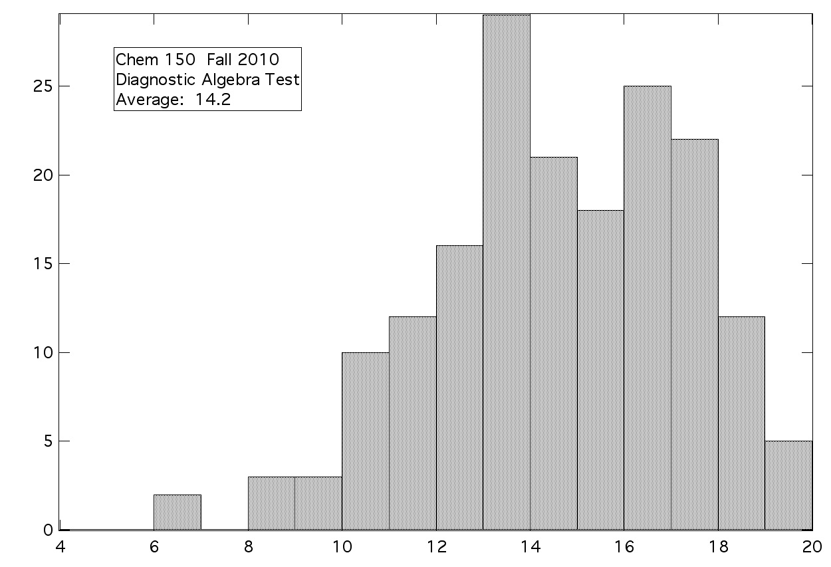
DAT Results for Fall 2010 (N=187)

Slide 9
Key Identifiers for “at-risk” students
Predictor | Spearman’s Rho
1. Declared White | 0.200**
2. Math ACT | 0.167*
3. Cumulative GPA | 0.173*
4. Question 3 on the DAT | 0.155*
5. Question 4 on the DAT | 0.217**
6. Question 5 on the DAT | 0.202**
7. Question 7 on the DAT | 0.186*
8. Question 14 on the DAT | 0.214**
9. Total score on the DAT | 0.186*
** Correlation is significant at the 0.01 level (2-tailed). * Correlation is significant at the 0.05 level (2-tailed).

Slide 10
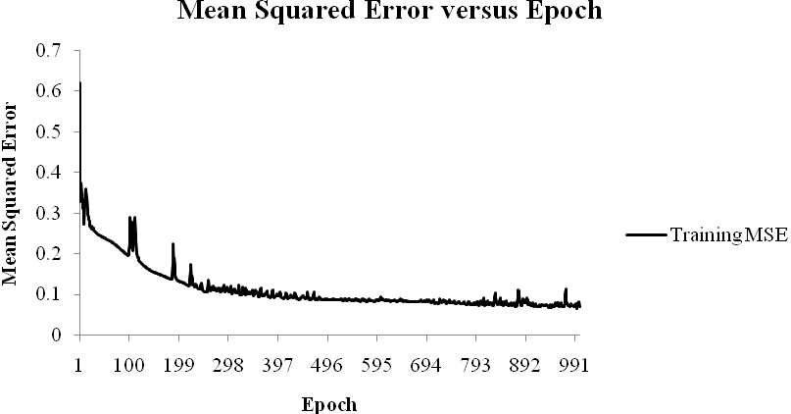
Student Data → Neural Network

Slide 11
Predictive System Accuracy
Neural network Output:
 | At-risk students (C- or below) | Not at-risk students (C or above)
Predicted to be at-risk | 34 | 11
Predicted not to be at-risk | 21 | 121
Categorical Accuracies:
 | All students | Accuracy of prediction | Error of prediction
Predicted to be at-risk | 45
Predicted not to be at-risk | 142

Slide 12
Overall Accuracy
At-risk students | Not at-risk students | All students
76% | 85% | 83%

Slide 13
Possible Treatments
Predictor | Possible Treatment
Declared White | Additional support/funding for the Native American Center (NAC) on campus. Recruitment and training of well-qualified tutors for the center.
Math ACT | Raise college admission standards.
Cum GPA | A concurrent support class that covers basic college study skills (e.g. note taking, time management, and motivation).
Q3 | These items are all mathematical topics as a subset of one of the math concepts listed within the Background section of this paper. A concurrent support course could possibly cover these topics in a “just-in-time” fashion via the coordination with the chemistry professors.
Q4
Q5
Q7
Q14
DAT Score (out of 20)

Slide 14
Questions?

